Slide 1
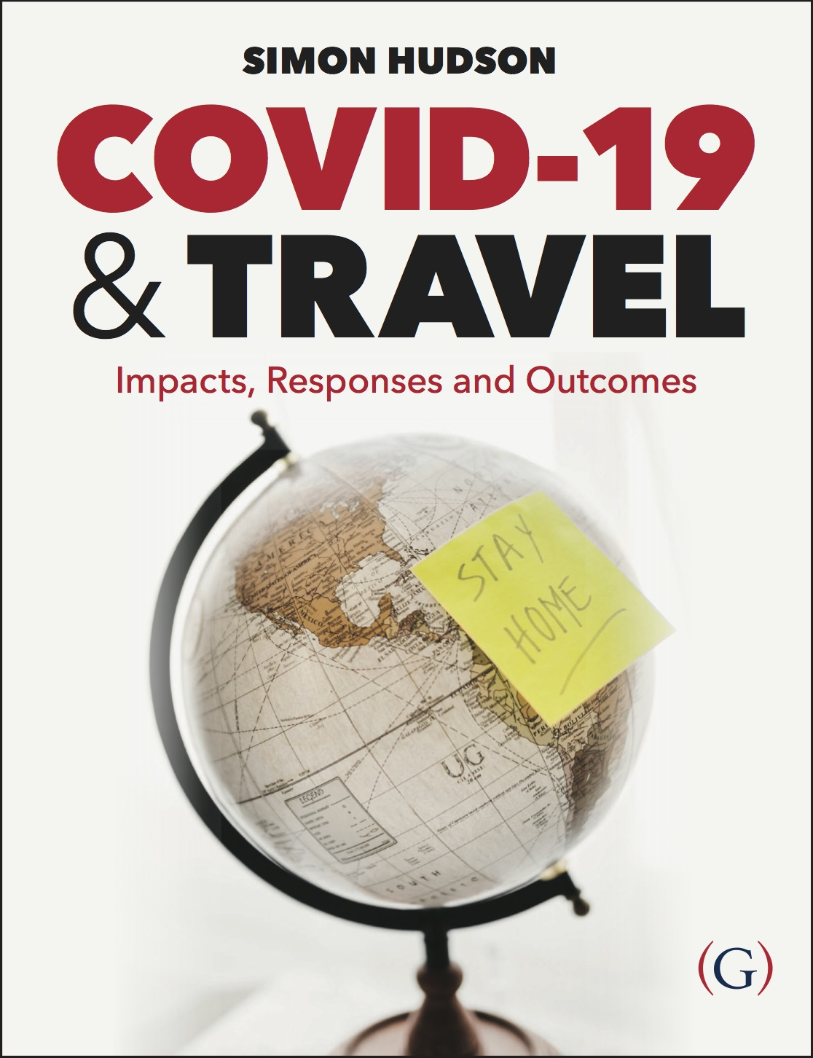
Chapter 5: The economic, social and environmental impacts of COVID-19

Slide 2
Topics Covered
Case Study: Bringing the ‘happy’ back to Aruba
Economic Impacts
Social Impacts
Environmental Impacts
Case Study: Italy: ”It was like having the rug pulled out.”

Slide 3
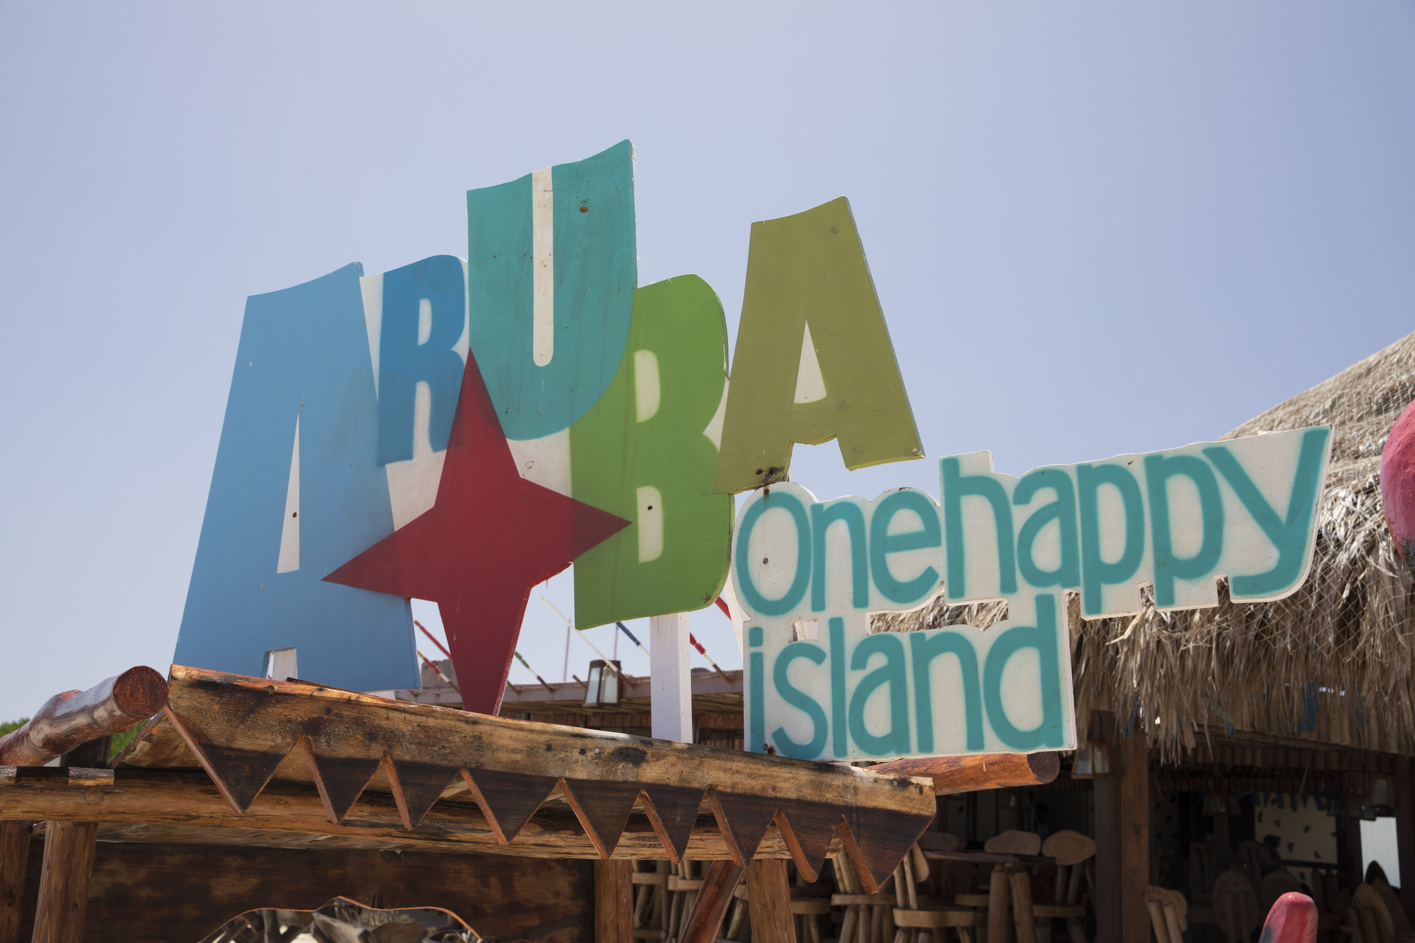
Case Study: Bringing the ‘happy’ back to Aruba
The Caribbean countries, making up a very tourism-dependent region of the world, attracted more than 31 million visitors in 2019, but tourism in the Caribbean was expected to decline by 60-70% from April to December 2020.
Tourism money is important for pumping money into the economy.
Dependency on tourism causes destinations like Aruba to have enormous pressure to re-open borders to visitors.
An Aruba Health & Happiness Code was designed to endure Aruba’s visitors that the island was dedicated to upholding the highest health and safety protocols.

Slide 4
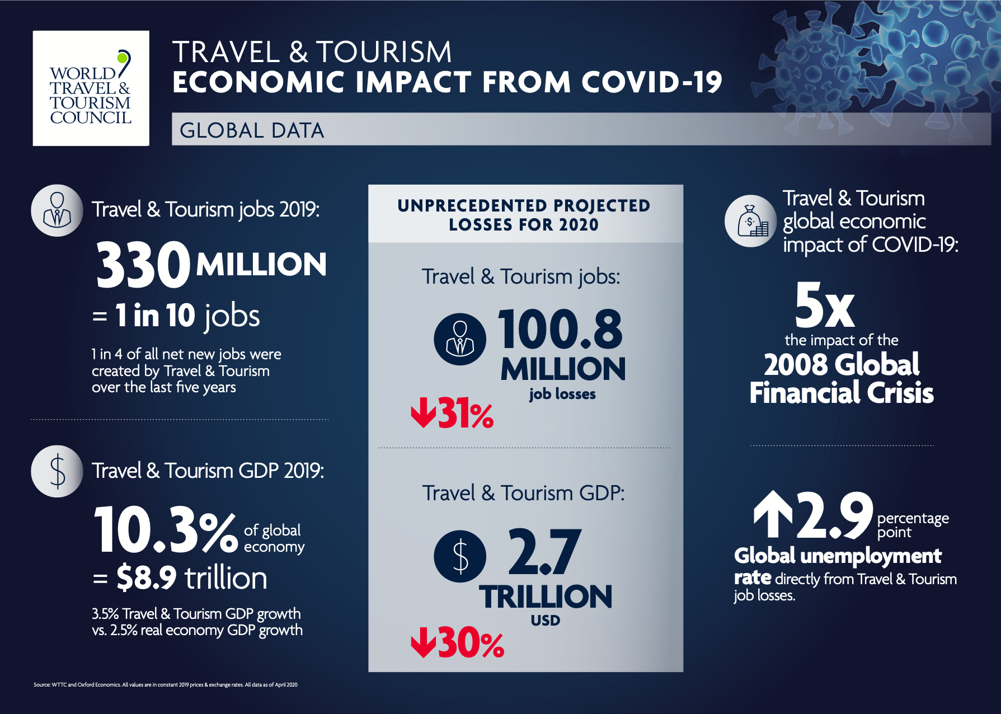
Economic Impacts
The WTTC predicted that the impact of COVID-19 on travel would be five times worse than the 2008 global financial crisis, with over 100 million jobs lost in 2020.
The most sever economic devastation is likely seen in the small island nations that have staked their entire economies on overseas travelers visiting those destinations’ beaches and resorts.

Slide 5
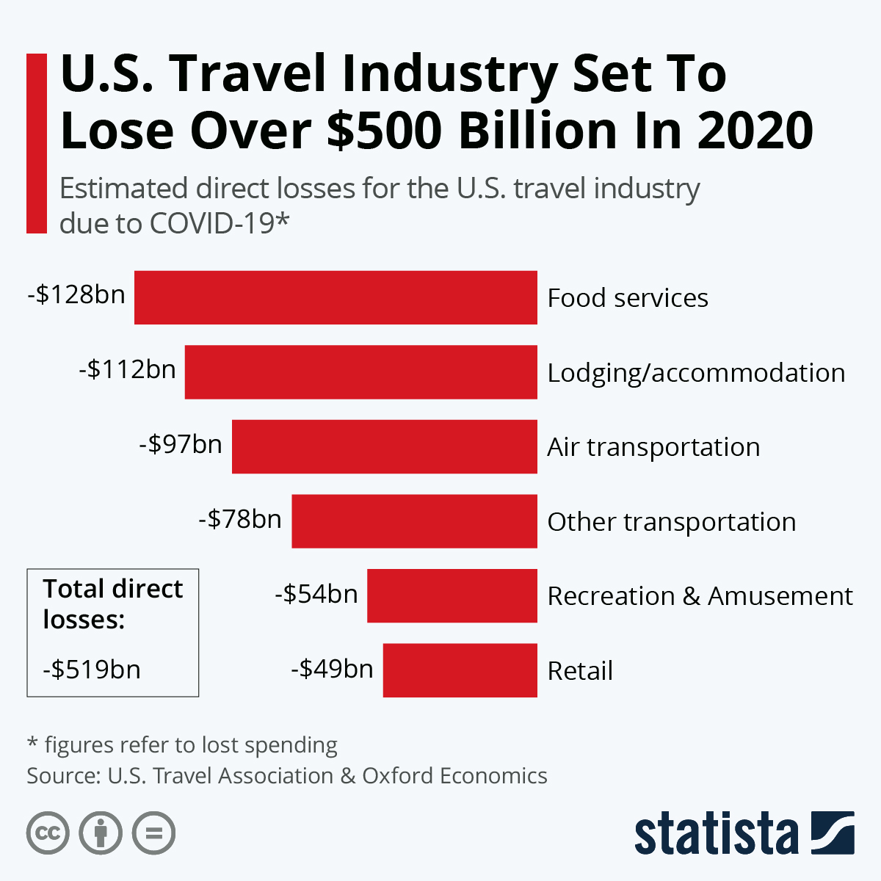
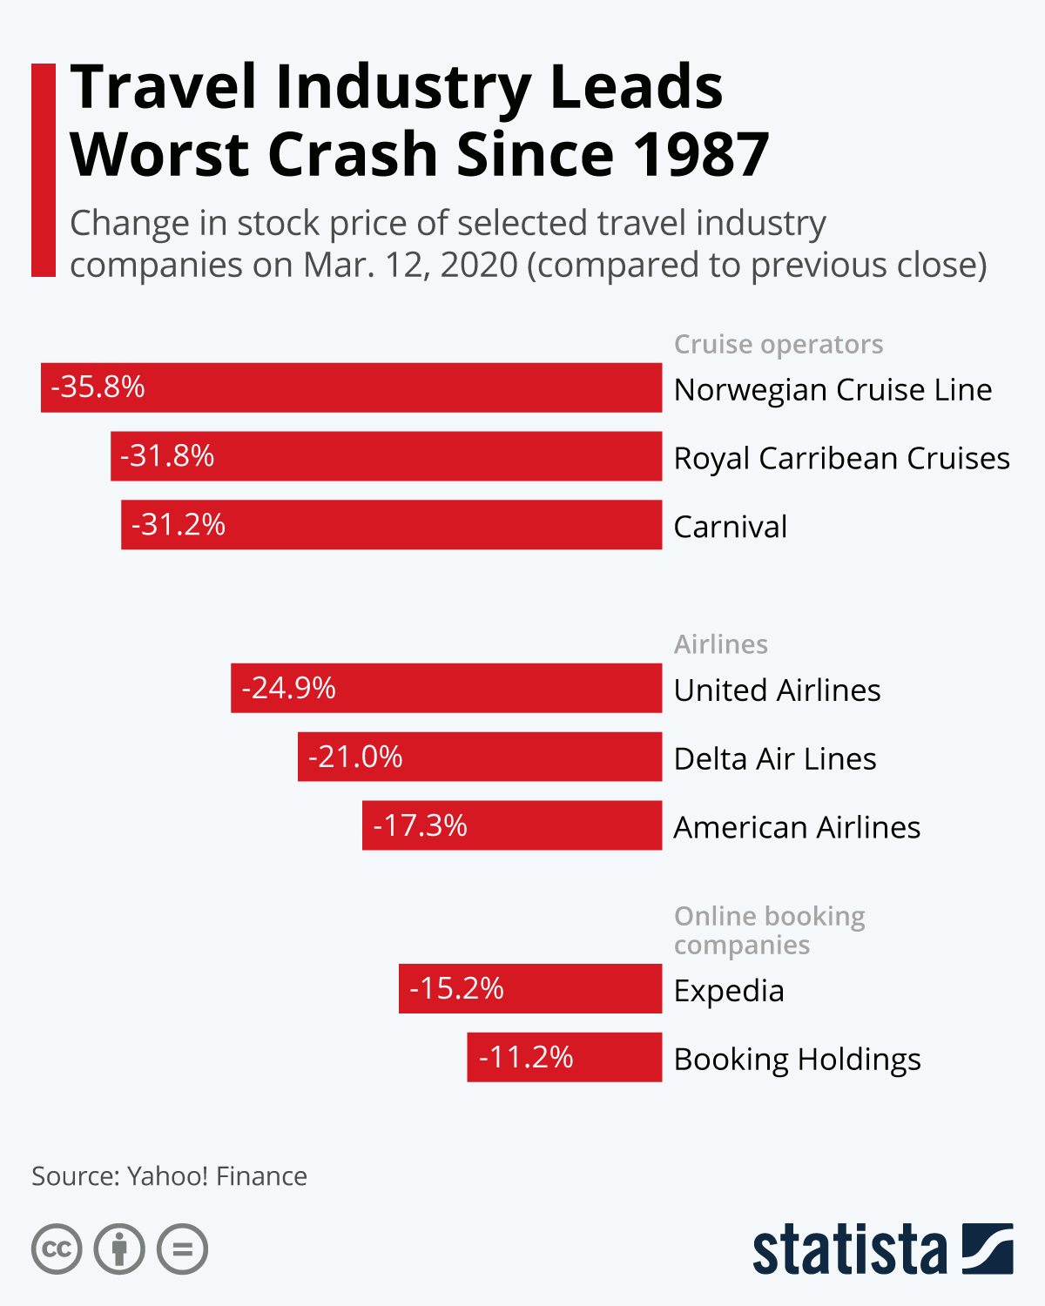
Economic Impacts
In absolute numbers, tourism in the US will see the greatest losses from COVID-19.
Including the loss of domestic tourism, the US was forecast to suffer a $519 billion declines in direct travel expenditures due to the pandemic.
Food services was set to have the highest fall in direct spending, followed by the lodging and air transportation sectors.
Suspended travel to slow the spread of the virus influenced stock markers everywhere to crash, led by airlines, cruise operators and online booking agencies.

Slide 6
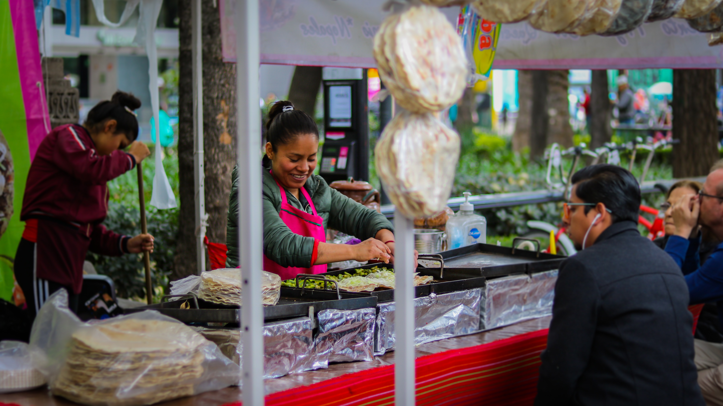
Economic Impacts
The cancelation of events, large and small, had devastating impacts on host destinations.
The AHLA found that as of May 6, nearly 7 out of 10 hotel rooms were empty across the US and hotels had already lost more than $21 billion in room revenue.
Major hotel managers reported suffering significant layoffs and furloughs.
Closing the doors of hotels puts many small businesses at risk.

Slide 7
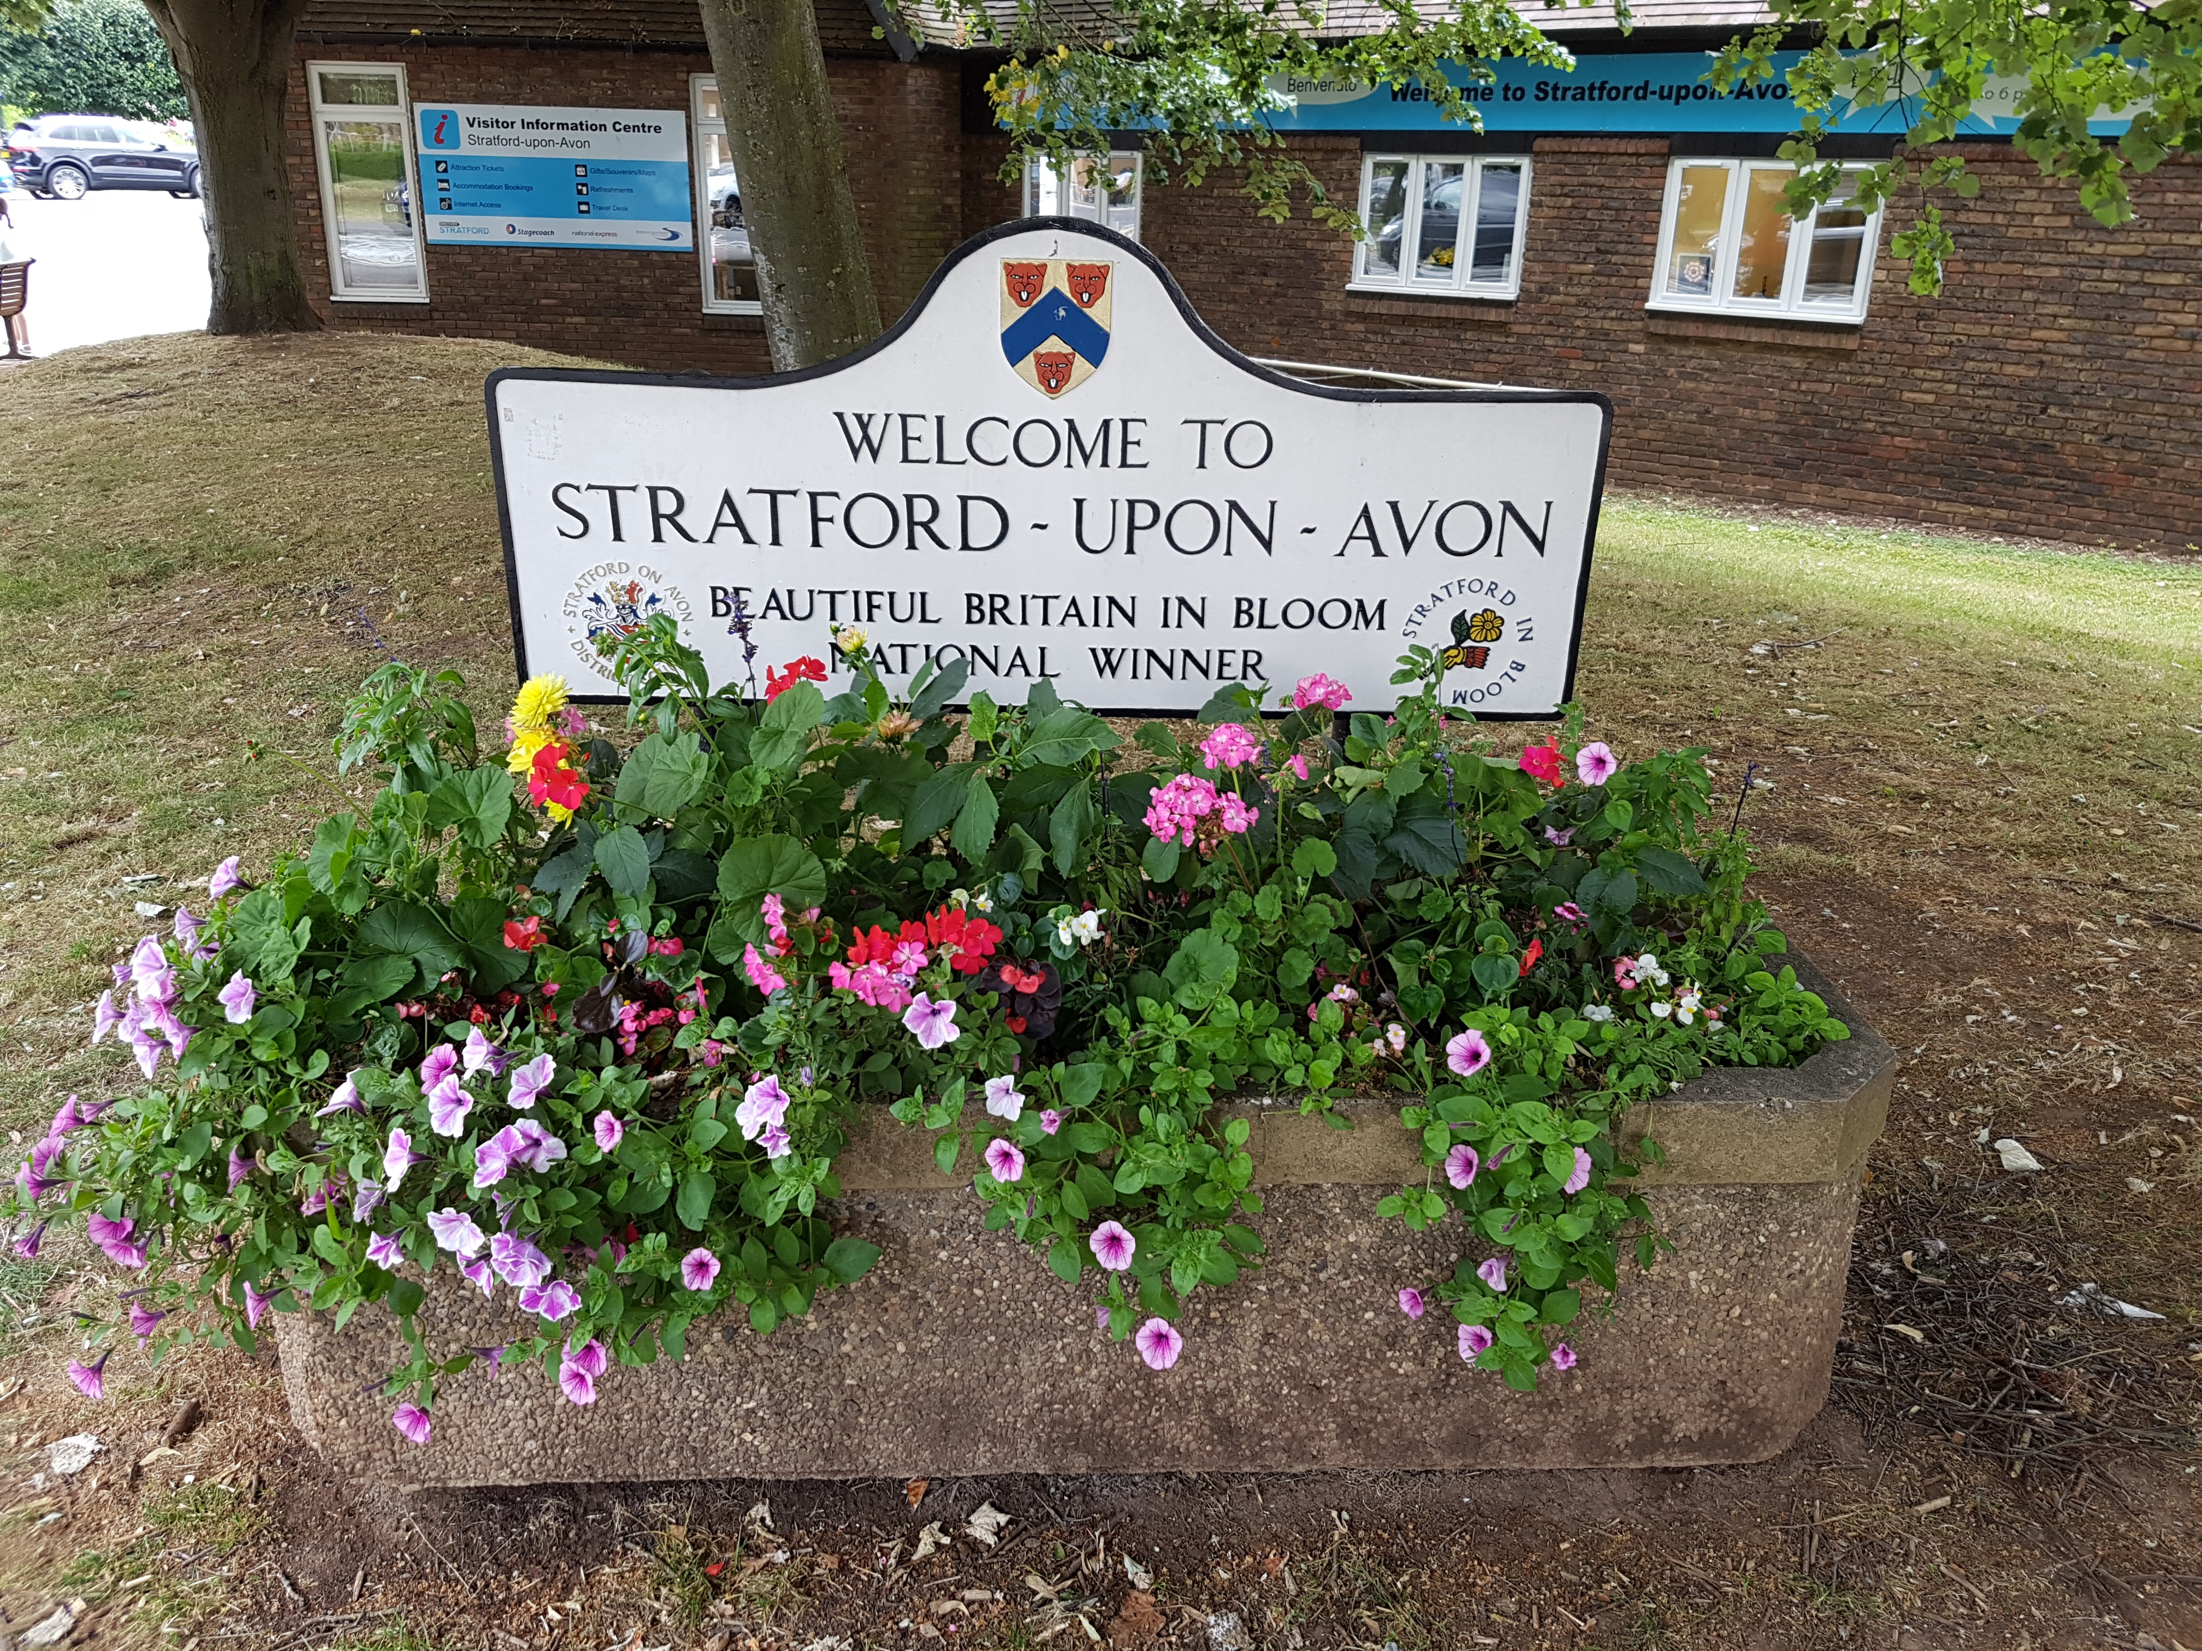
Economic Impacts
Businesses were forced to close almost overnight in some communities.
Stratford-upon-Avon, the birthplace of the world-famous William Shakespeare, holds and cares for a lot of history, which predicts to fall in income by millions of dollars in 2020.
Regions that usually fill with visitors for specific attractions sat empty, closed to all visitors.
Businesses, especially small businesses, were facing additional costs of starting up again.
Sanitary demands and staffing were large concerns for re-opening to few customers, and many were not able to re-open at all.

Slide 8
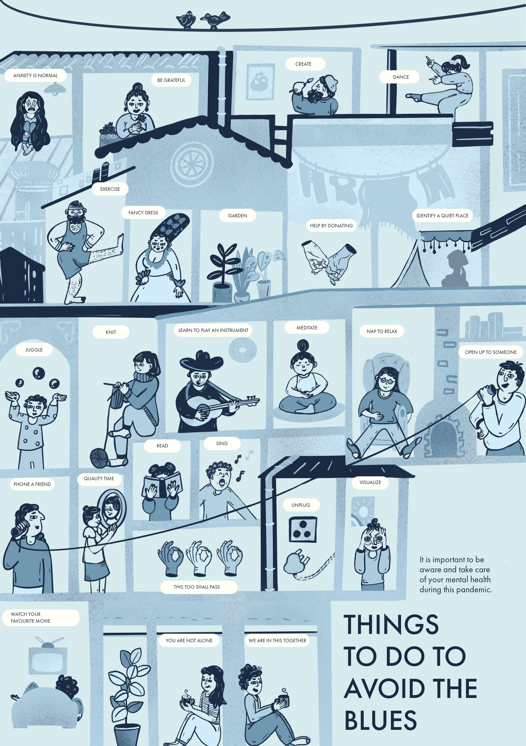
Social Impacts
David Malpass, the president of the World Bank, warned that millions of people would be pushed into extreme poverty by the crisis, and poorer countries would suffer most.
Lockdowns were cut short due to fears of not making enough money to eat and pay for essential water, electricity, and housing.
A United Nations report in May 2020 threw attention onto a mental illness crisis due to deaths, disease, forced isolation, poverty, and anxiety of the pandemic.
Some residents felt uneasy about re-opening to visitors in their local areas and many even put up home-made signs urging non-locals to go home.

Slide 9
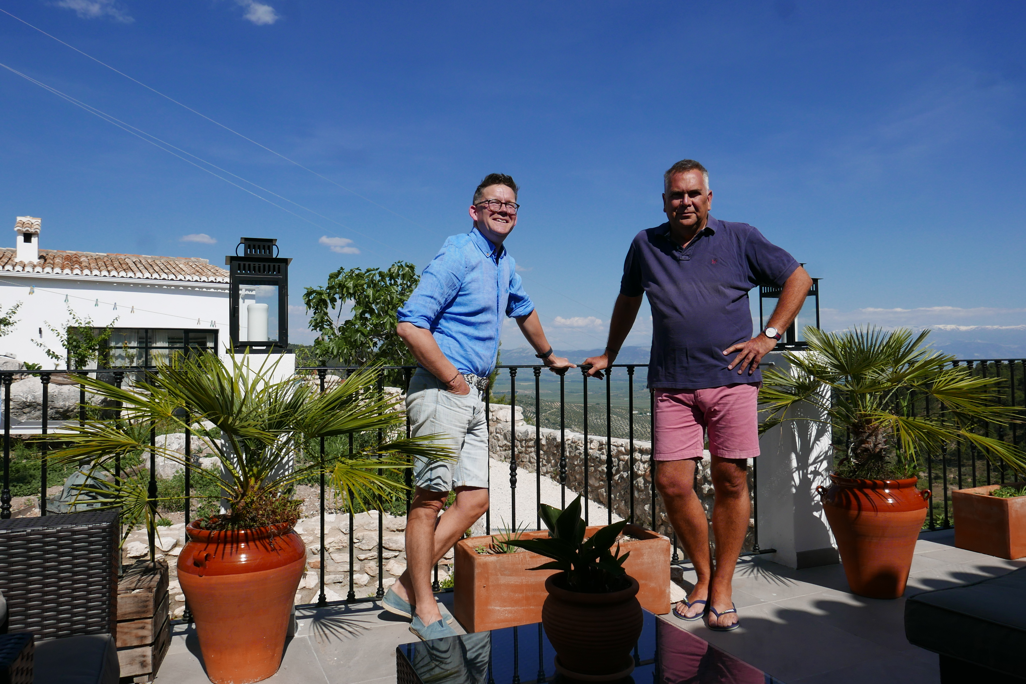
Social Impacts
The lockdown period brought on increasing acts of kindness around the world, from delivering food to free exercise classes, free virtual concerts from music stars, donations, and free handmade PPE for essential workers.
Two tourism entrepreneurs launched a campaign to assist the travel sector and essential workers by offering free vacations to healthcare workers from accommodation providers.
Dictionaries were updated to reflect life during the pandemic, adding terms such as ‘social distancing’, ‘self-quarantine’, ‘contact tracing’, ‘self-isolating’, and COVID-19.

Slide 10
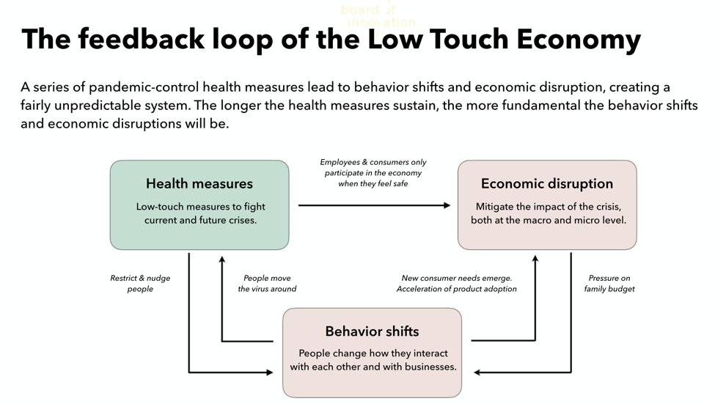
Social Impacts
The ‘Low Touch Economy’ was a term coined to describe the new state of society and economy characterized by low-touch interactions influenced by COVID-19.
With society being focused on low-touch interactions, the Board of Innovation suggests companies adapt their business models to work with health measures and challenges presented by COVID-19 for the long run.
Some low-touch interactions – like contactless payment - proved to be easier for society to get used to than other interactions.
Companies having their employees work from home was a key social trend brought on by COVID-19.

Slide 11
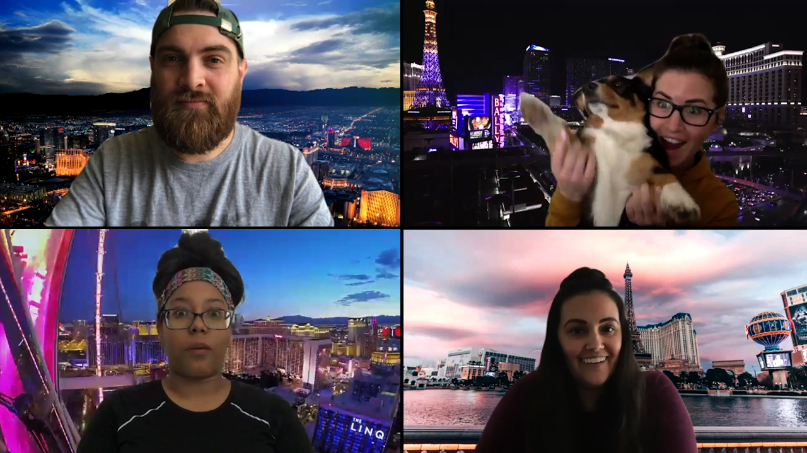
Social Impacts
Amid the pandemic, people transitioned to virtual socialization using platforms like TikTok and Zoom.
Virtual dating increased during the pandemic due to the lack of new connections that would be made in-person before the pandemic.
Zoom’s company had perhaps the most dramatic growth in use as a video conferring provider, whose market capitalization skyrocketed.

Slide 12
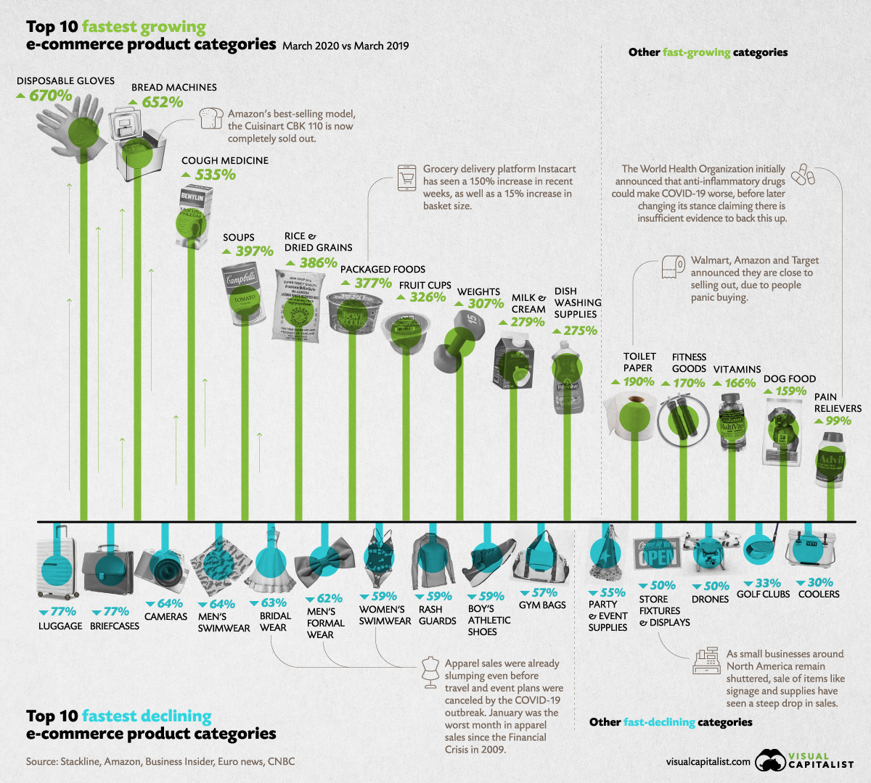
Social Impacts
Buying behavior in society adapted to suit needs of health and safety, causing online shopping to expand.
Businesses like Amazon struggled in the beginning to keep up with consumer demand and had to delay the delivery of non-essential items.
Products used to suit travel needs were not as high in demand during the lockdown period, so e-commerce trends saw a fall in the sales of luggage, cameras, and women’s swimwear.
Panic buying was a behavior of many consumers upon rising cases of COVID-19 caused by fear of scarcity.
The sales of toilet paper increased 190% due to panic buying.

Slide 13
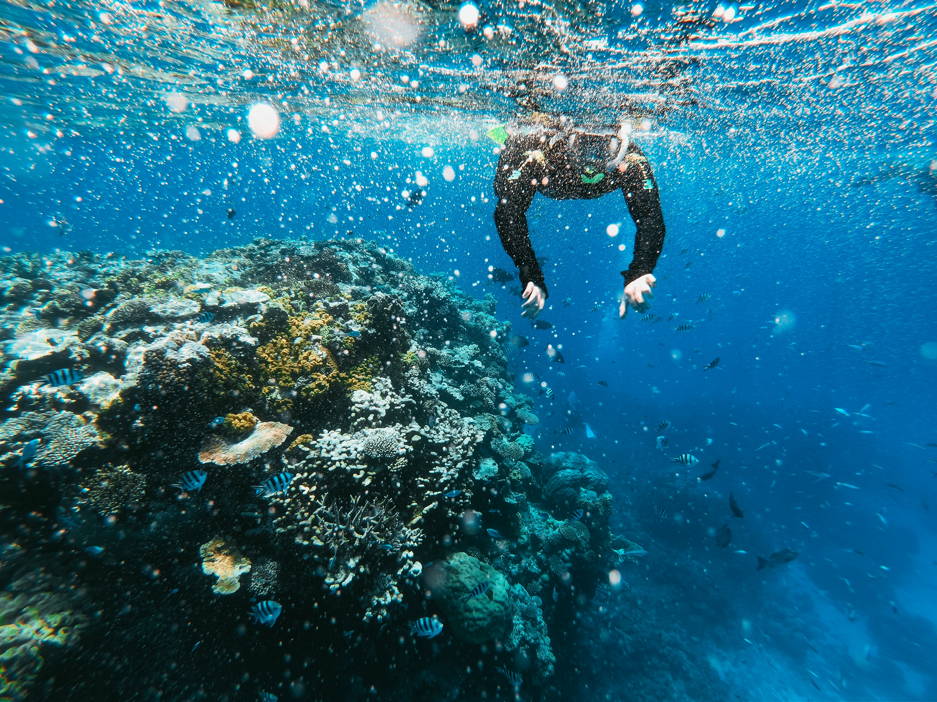
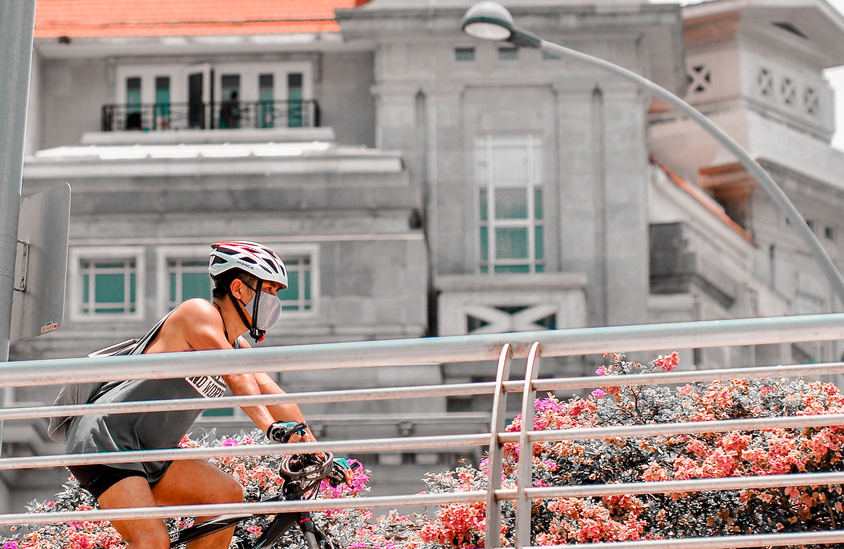
Environmental Impacts
The extreme decreases in energy use and CO2 emissions during the lockdown period of the COVID-19 pandemic are likely to be temporary, as they do not reflect structural changes in the economic, transport or energy systems.
The “travel pause” taken is an opportunity to take on more green practices
Many European cities used the crisis to re-evaluate their transportation policies, allowing more protection and accommodation for bikes and pedestrians.

Slide 14
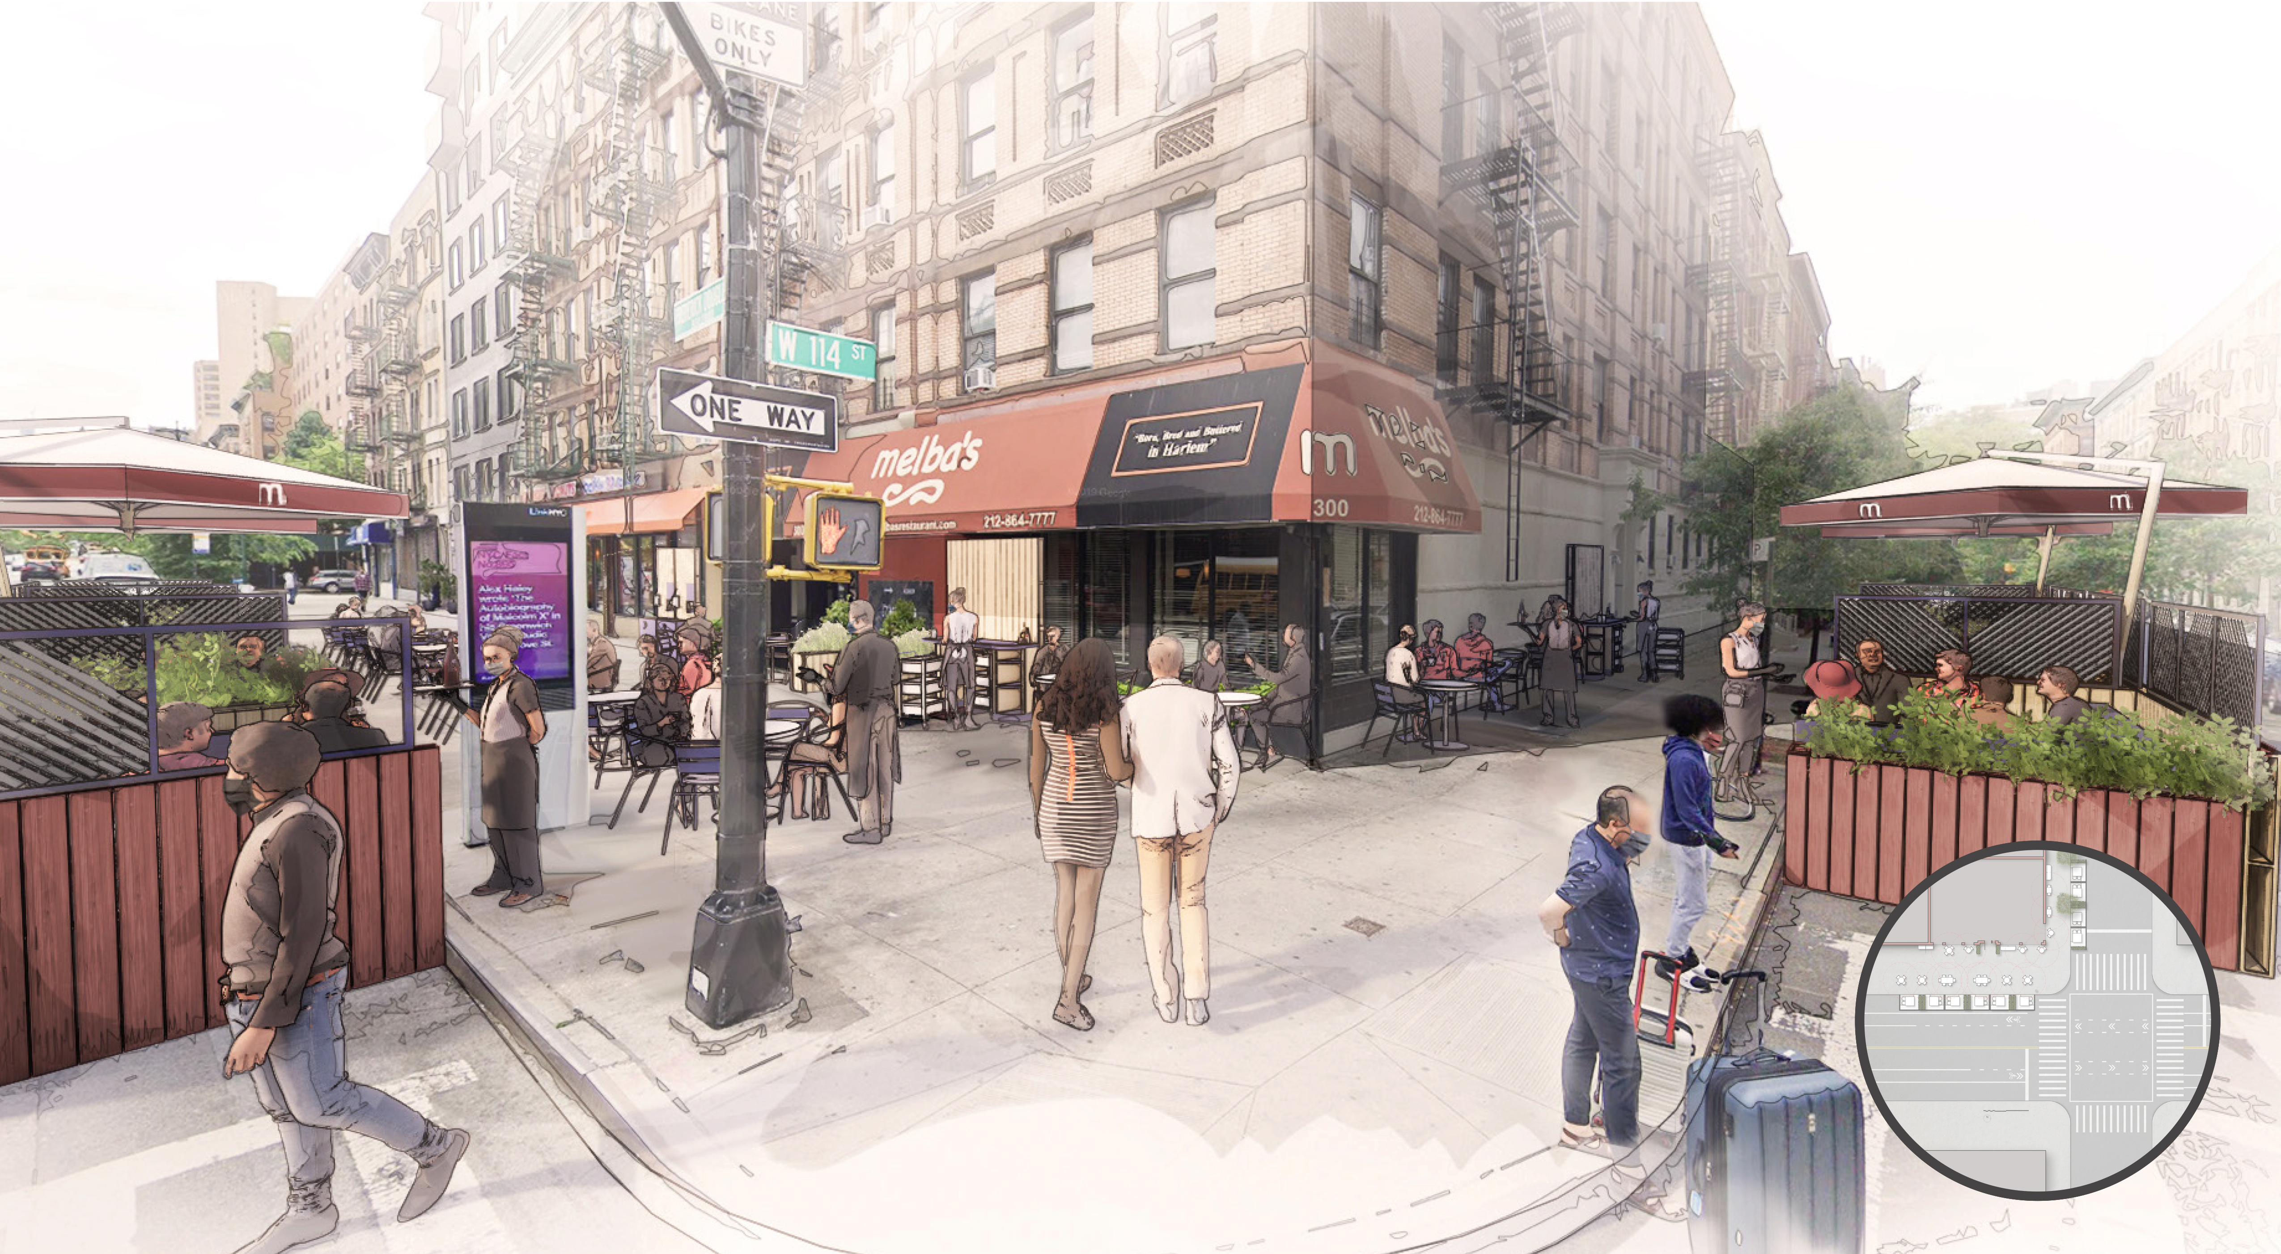
Environmental Impacts
Redesigning outdoor environments was a popular action done by cities everywhere to allow for additional space for socially-distanced dining.
With re-opening guidelines forcing businesses to operate at about half the normal capacity, additional seating was made possible in outdoor space.
The collapse of tourism in certain regions of the world threatened wildlife within those areas due to slashed revenue from tourism in parks.
The absence of visitors meant that park wildlife caretakers struggled to afford food for the animals.

Slide 15
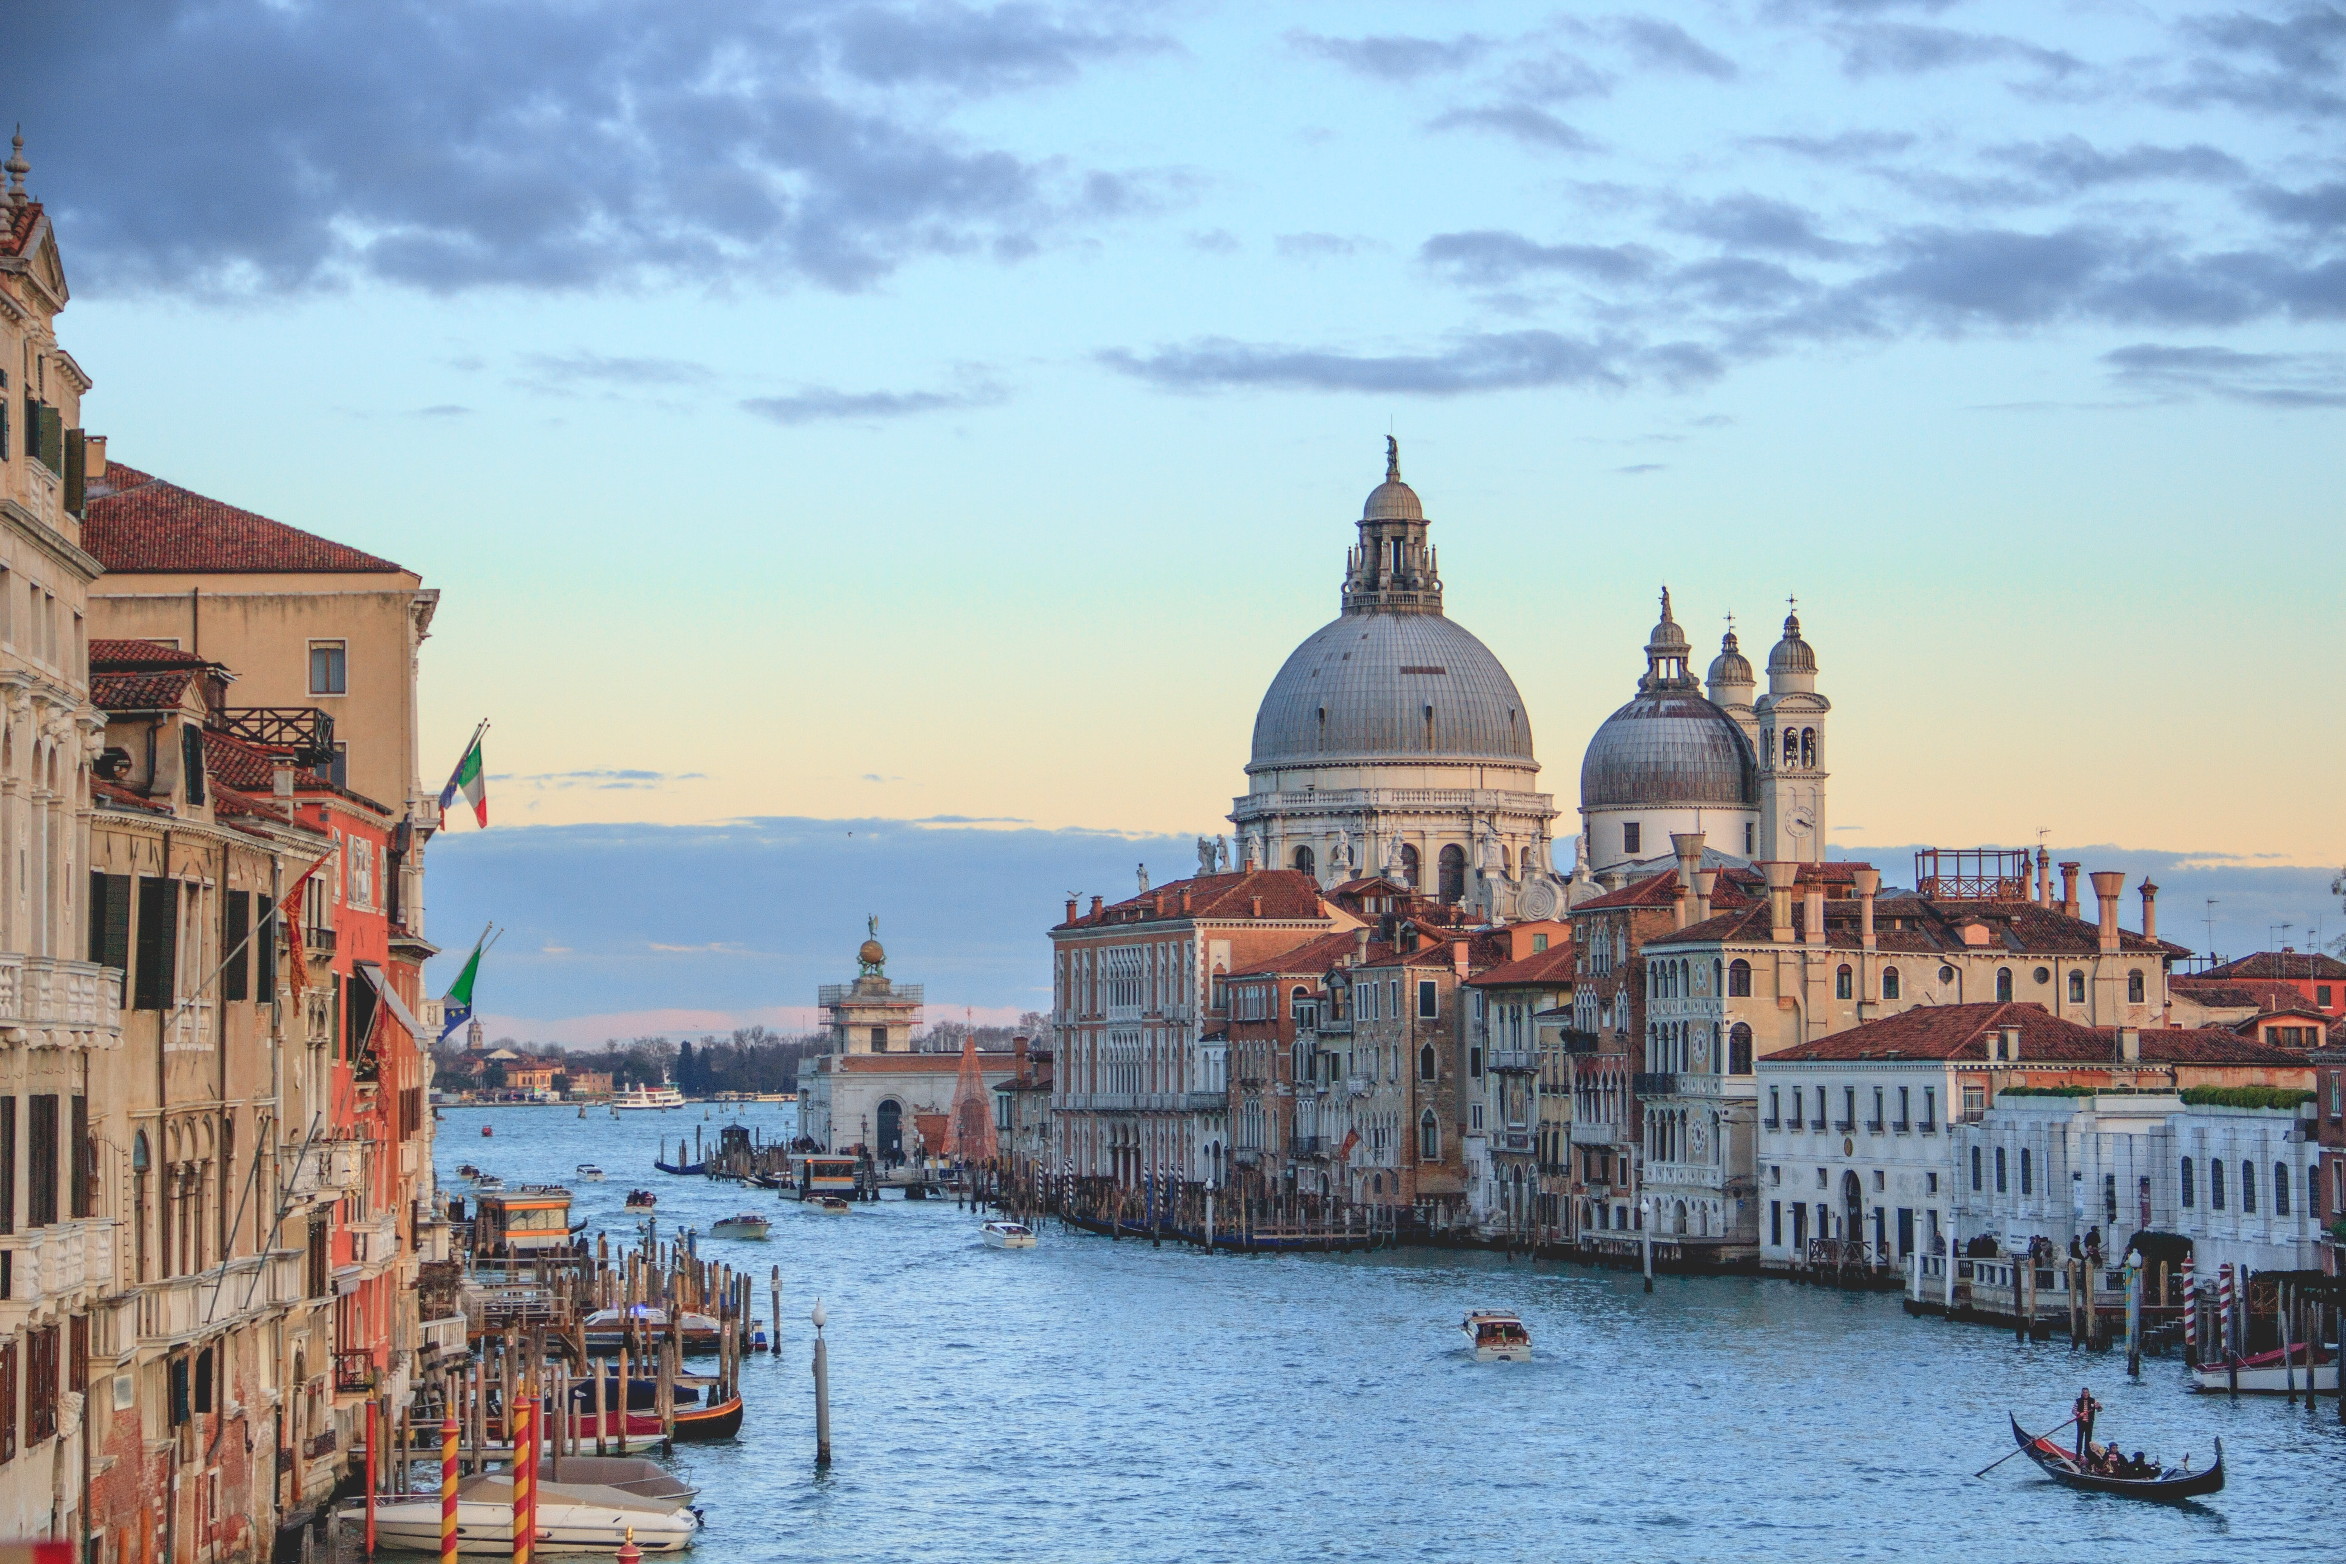
Case Study: Italy: “It was like having the rug pulled out.”
Italy was one of the worst-affected nations from massive unemployment and economic hardships.
The shock of canceling Carnival really woke everyone in the nation up to act on recovery.
Italy’s tourism minister led hard work in balancing safety concerns and the reopening of tourism facilities.
The pandemic was a turning point for Italians to become intelligent tourists and conscious of the world around them.
Patriotism is renewed in Italy as a result of common needs for travel.

Slide 16
Video Links
Aruba Health and Happiness Code → https://www.youtube.com/watch?v=emc3nL4GKps
COVID-19 Domino Effect Human → https://www.youtube.com/watch?v=vDpWjVYFOKI
COVID-19 Mental Health Care → https://www.youtube.com/watch?v=EW8GZa7zp9g
My Travel Pledge → https://www.youtube.com/watch?v=cmCbmGH7JmI
New English Words and COVID-19 → https://www.youtube.com/watch?v=mVYI2gxX0IQ
Zoom offers Las Vegas Backgrounds → https://www.youtube.com/watch?v=zkGJru61BbQ
COVID-19: Carbon emissions and climate change (UEA London Lectures 2020) → https://www.youtube.com/watch?v=CB2yPX8FH2c , 3:40-25:47 about the world before COVID-19 and trends in global carbon emissions, separating data by sector, and UEA Professor Corinne Le Quere’s expertise on how to act post-COVID-19 to help meet climate commitments
WORLD VS VIRUS PODCAST | EP 6: Can Climate Action survive COVID-19? ft. Greenpeace's Jennifer Morgan → https://www.youtube.com/watch?v=UPbrNRU0gWk
Insider Video: Bruce Poon Tip’s Vision for Travel After the Crisis → https://www.youtube.com/watch?v=bsPX6zVKaM0
Italy to reopen for tourists after strict coronavirus lockdown | DW News → https://www.youtube.com/watch?v=HRzkEARcLCQ

